Slide 1
NUTRITION SERVICES
OVERVIEW
2015 - 2016

Slide 2


SAFETY MOMENT: Distracted Driving – Facts
Put Down Your Phone
Five seconds is the average time your eyes are off the road while texting. When traveling at 55 mph, that's enough time to cover the length of a football field blindfolded.
Cell phone use contributes to 25% of all crashes.

Slide 3
National School Lunch HISTORY & REGULATIONS
1946 ~ Richard B. Russell National School Lunch Act
  Established National School Lunch Program (NSLP)
  Supported Farmers by Absorbing Farm Surpluses
Major Updating with Healthy, Hunger-Free Kids Act of 2010
  Institute of Medicine of the National Academies
    Updates Nutritional Recommendations Every 5 Years
USDA Sets Regulations & States Audits Programs
  DYK: Program has it’s own food labels? CN Labels
  DYK: Oversees Program Meal Prices? Lunch Price Equity
  DYK: State Fiscal Onsite Audit Every Year?
  DYK: State Program Onsite Audit Every Three Years?
    Completed review 2015-16 School Year

Slide 4
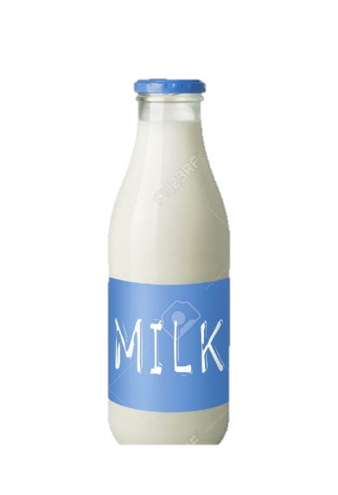


Where do we source our food?
  USDA Commodities 15% Spend
  Dairy – Bread – Produce 60% Spend
  100% - 100% - 20% Local
  Grocery Items 25% Spend

Slide 5
Your Nutrition Service Information
We serve over 255,000 meals per year
  25% from Breakfast & 75% from Lunch
Lunch Options
  Primary/Intermediate Three Daily Offerings
  Yale Two Daily Offerings
  Middle School Thirteen Daily Offerings
  High School Fourteen Daily Offerings
Breakfast Options
  K-12 Three Daily Offerings
Summer Food Service Program 3,675 meals

Slide 6
Participation

Slide 7
DEMOGRAPHIC

Slide 8
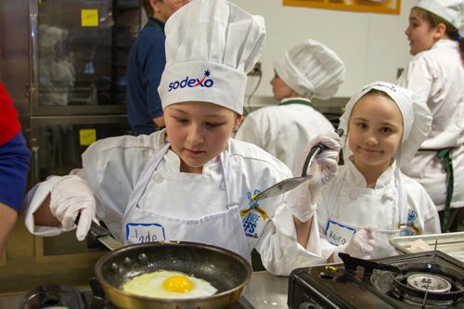
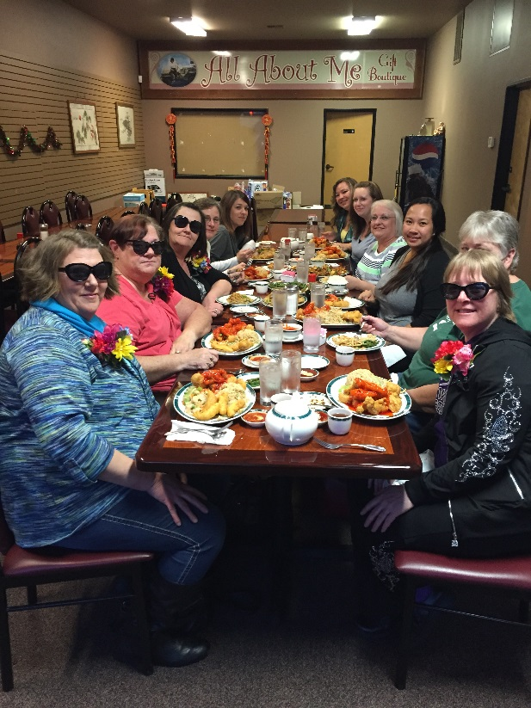
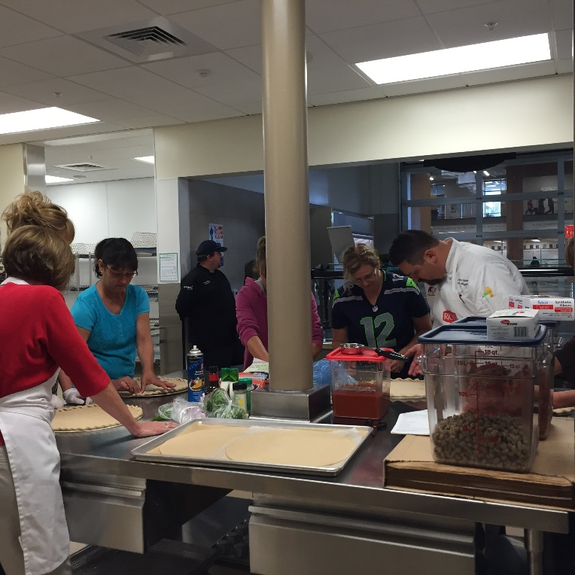
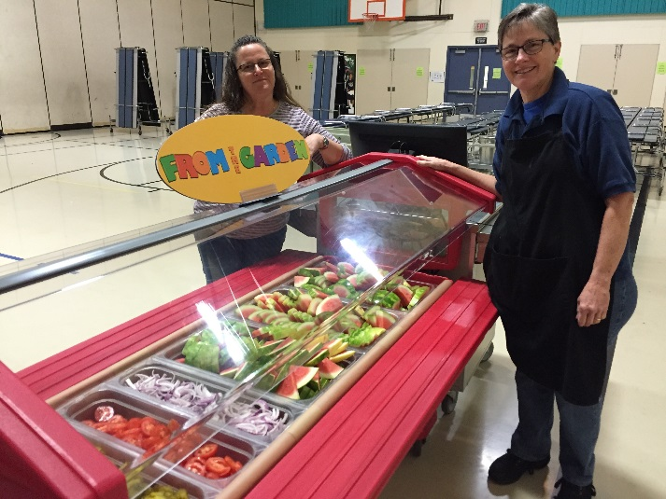
Program Notables

Slide 9


Student Engagement Programs
Club House at Primary and Intermediate
DYK at the Middle School
A to Z Fruit / Vegetable
  Each Week a New Fruit Or Vegetable Will Be Introduced to Elementary Students at Lunch

Slide 10

Student Engagement Programs
Bi-Monthly Meetings with High School Marketing Class
Middle School Leadership
Online Student Survey
Tablet Survey

Slide 11
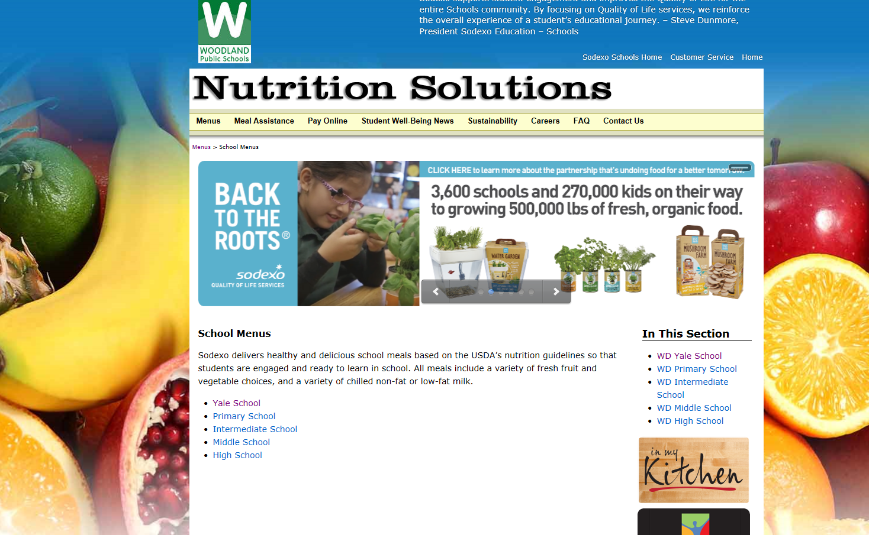
Student Engagement Programs

Slide 12
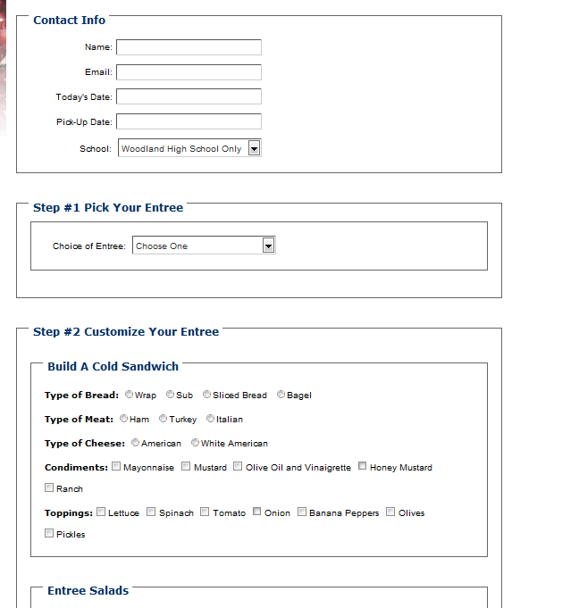
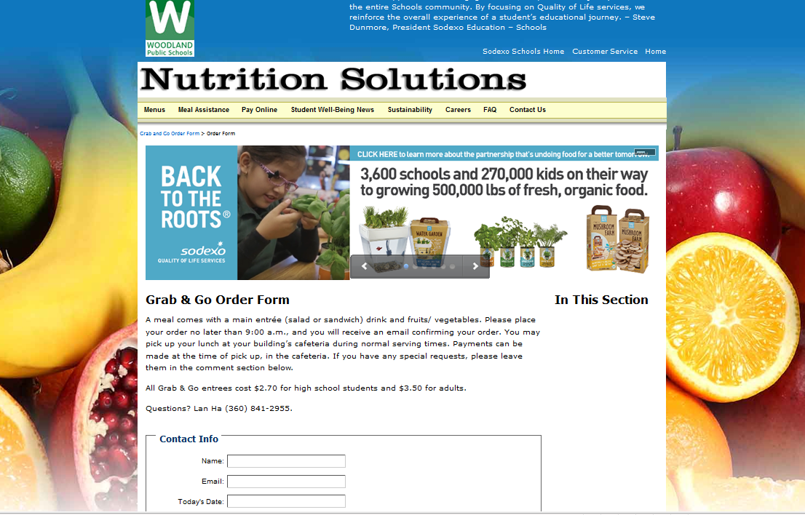
Innovation
Grab & Go

Slide 13
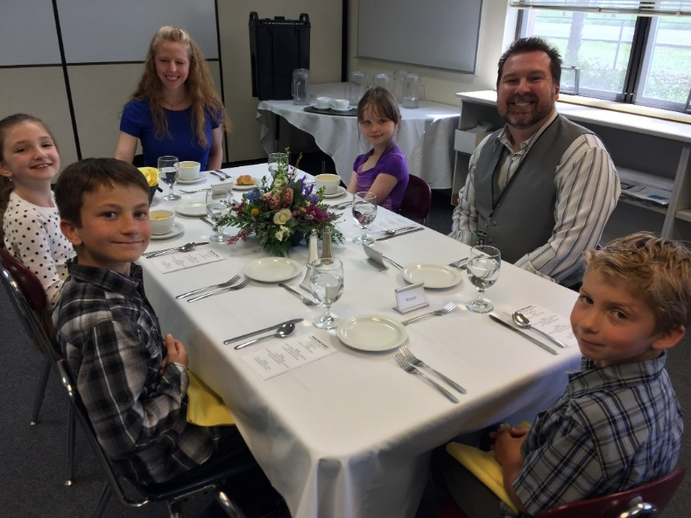
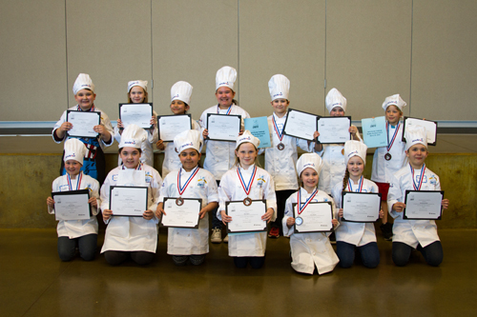
Student Engagement Programs
CONTINUE STUDENT PROMOTIONS
  Heathy High School Challenge
  Future Chefs Contest
  Fine Dining Event

